Slide 1
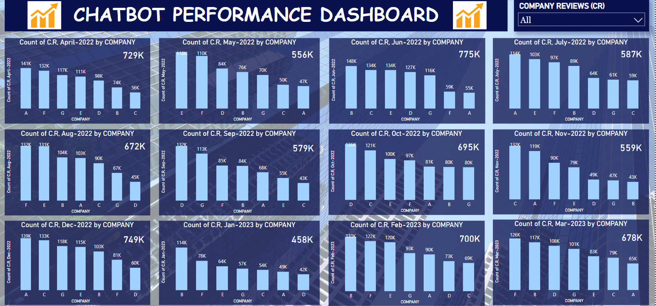
Few Insights on Chatbot Performance on the basis of company reviews by each company!

Slide 2
WEBSITE USERS
Website Users covers the highest number of company Reviews across all companies.
Top 3 company with highest number of website users
Company B in June 2022
Company A in April 2022
Company B in February 2023
Top 3 months highest count of website users
June 2022
December 2022
April 2022

Slide 3
CHATBOT BROCHURE DOWNLOADS
Top 3 company with highest number of chatbot brochure downloads
Company G in February 2023
Company A in February 2023
Company F in November 2022
Top 3 months with highest count of chatboat brochure downloads
March 2023, July 2022
January 2023
August 2023

Slide 4
CHATBOT LEADS
Top 3 company with highest number of chatbot Leads
Company E in september 2022
Company D in July 2022
Company F in November 2022
Top 3 months with highest count of chatboat Leads
May 2022
June 2022
September 2022

Slide 5
CHATBOT QUERIES
Top 3 company with highest number of chatbot queries
Company G in February 2023
Company B in April 2022
Company G in October 2022
Top 3 months highest count of chatboat queries
November 2022
September 2022
July 2022

Slide 6
CHATBOT USERS
Top 3 company with highest number of chatbot users
Company B in September 2022
Company B in May 2022
Company A in November 2022 and October 2022
Top 3 months highest count of chatboat users
October 2022
July 2022
November 2022

Slide 7
WEBISTE LEADS
Top 3 company with highest number of website leads
Company A in August 2022
Company B in April 2022
Company A in November 2022
Top 3 months highest count of website leads
August 2022
June 2022
October and November 2022

